Slide 1
Introduction to SEIR modelling

Slide 2
What is a SEIR model?
S (Susceptible): People that are susceptible to the disease, or people who might get the disease
E (Exposed): People who were infected by the virus (currently has the virus), and can transmit the virus to other susceptible, but who has not developed symptoms (carriers)
I (Infected): Similar to exposed, infected are who has the virus, transmissive, and might have or not have symptom.
Ip (preclinical): Symptomatic patients who has not yet developed the symptom
Is (subclinical): Asymptomatic patients
Ic (clinical): Symptomatic patients who has the symptom
R (removed): People who has recovered/demised

Slide 3
Geographical Stratification
Ontario has
26 Public Health Units
50 administrative districts
528 counties
We have following data of each county:
Population
Commuting matrix

Slide 4
Age stratification
We stratified the Ontario population into 16 age-bands, as
{0 to 4, 5 to 9, … , 70 to 74, 75 +}
To correspond with the contact matrix, case-fatality-rate, susceptibility, and vaccination level

Slide 5
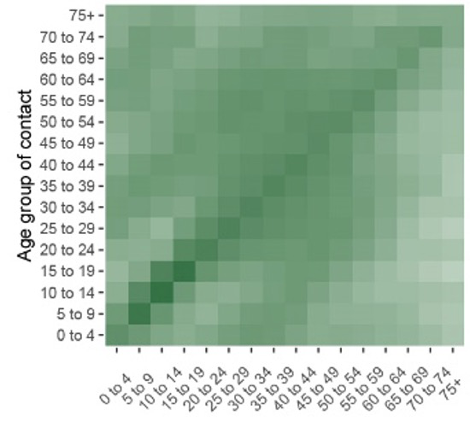

Contact matrix
A $16 × 16$ matrix.
Each row represents a five-year age band of contacters
Each column represents a five-year age band of contactees

Slide 6

Commuting matrix
A $528 × 528$ matrix.
Each row represents a county of residence
Each column represents a county of work

Slide 7
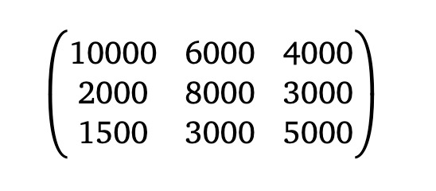
A simpler view
Let’s consider the case where there are only three counties.
Here, we know
No. people live & work in Toronto: 10000
No. people live in Toronto & work in Markham:”
2000
Etc.
Toronto
Markham
North York

Slide 8
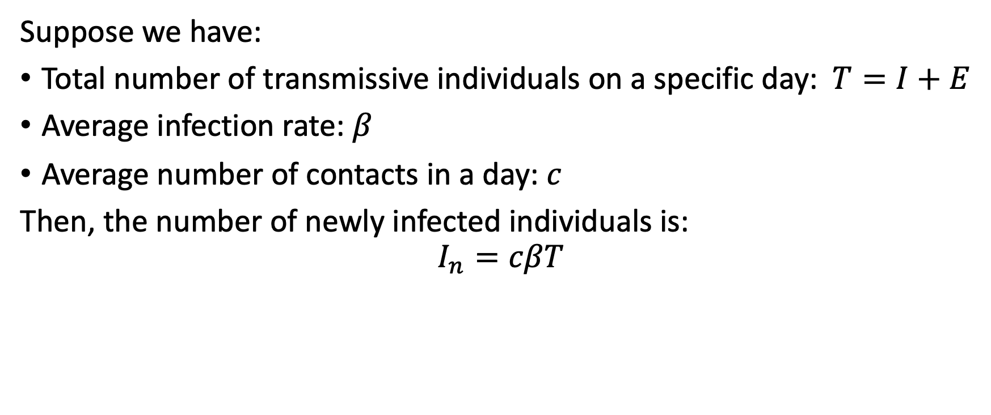
Modelling infection – naïve
Suppose we have:
Total number of transmissive individuals on a specific day: $T=I+E$
Average infection rate: $β$
Average number of contacts in a day: $c$
Then, the number of newly infected individuals is:
$$I_{n}=cβT$$

Slide 9

Naïve model – cont.
The distribution function of a removal:
We use ReLU after a specific date, according to Lancet paper, to represent the probability distribution of a specific patient that will recover/decease after $n$ days of initial infection.

Slide 10
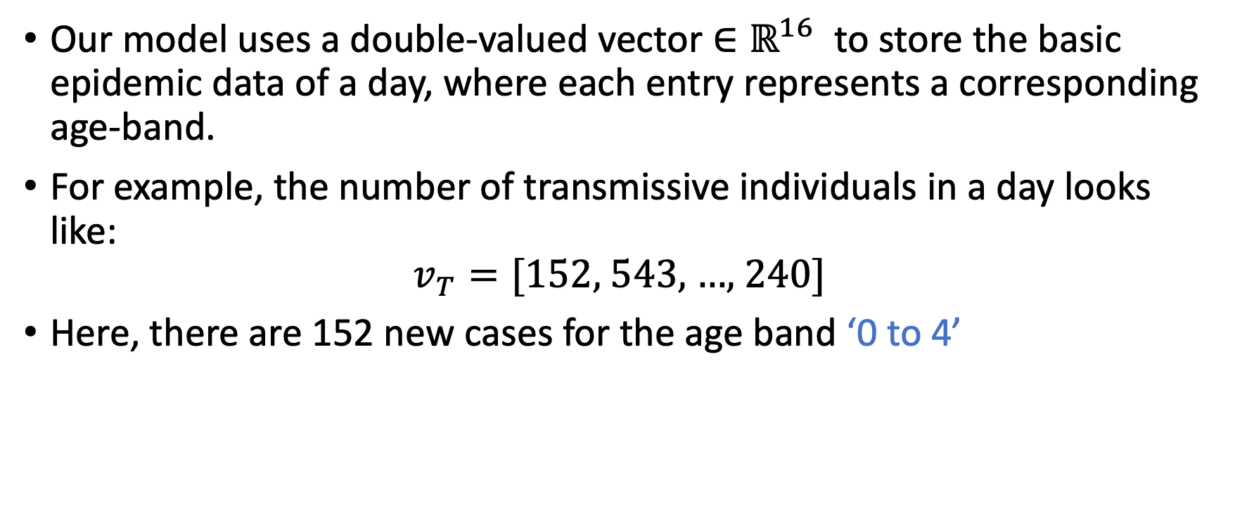
How does our model look like?
Our model uses a double-valued vector $∈ℝ^{16}$ to store the basic epidemic data of a day, where each entry represents a corresponding age-band.
For example, the number of transmissive individuals in a day looks like:
$$v_{T}=\text{[152, 543, …, 240]}$$
Here, there are 152 new cases for the age band ‘0 to 4’

Slide 11
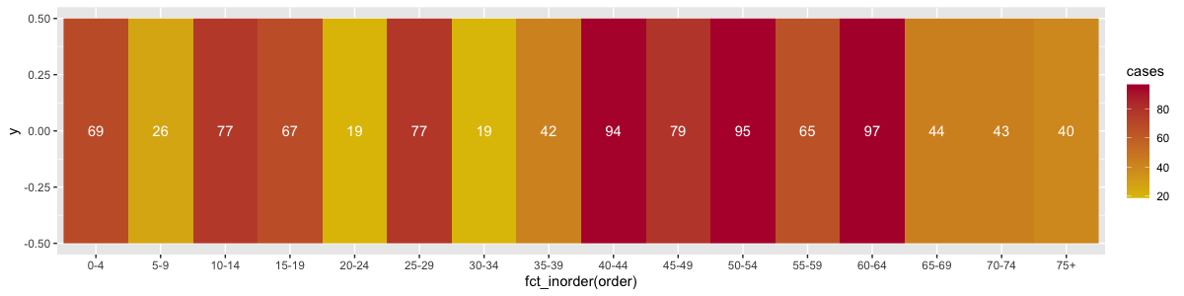
How does our model look like?
This is how the number of transmissive individuals might look like.
Color indicates the number of cases.

Slide 12
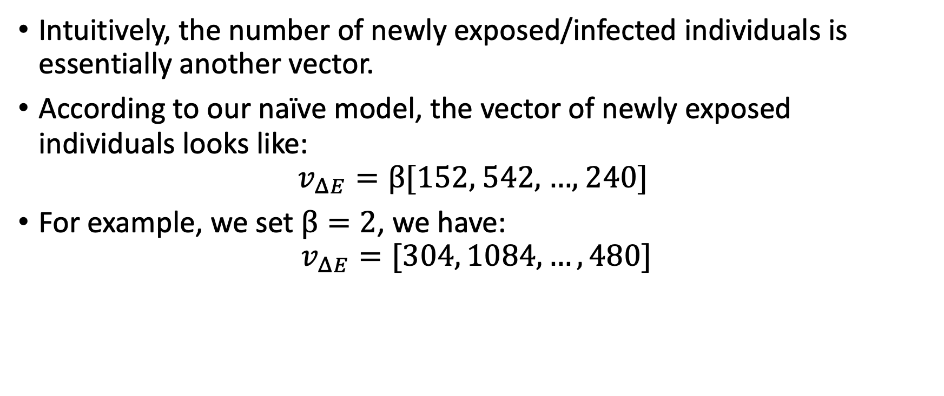
How does our model look like? – cont.
Intuitively, the number of newly exposed/infected individuals is essentially another vector.
According to our naïve model, the vector of newly exposed individuals looks like:
$$v_{ΔE}=β\text{[152, }\text{542}\text{, …, }\text{240}\text{]}$$
For example, we set $β=2$, we have:
$$v_{ΔE}=[304, 1084, …, 480]$$

Slide 13
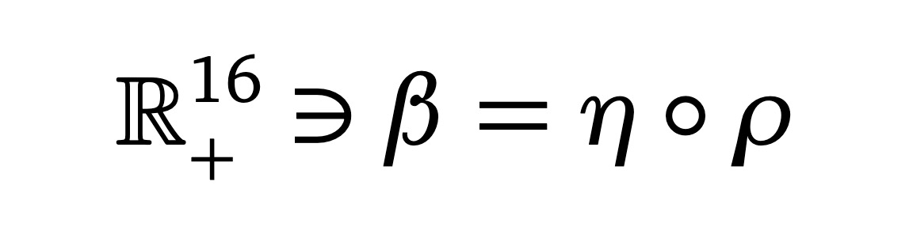
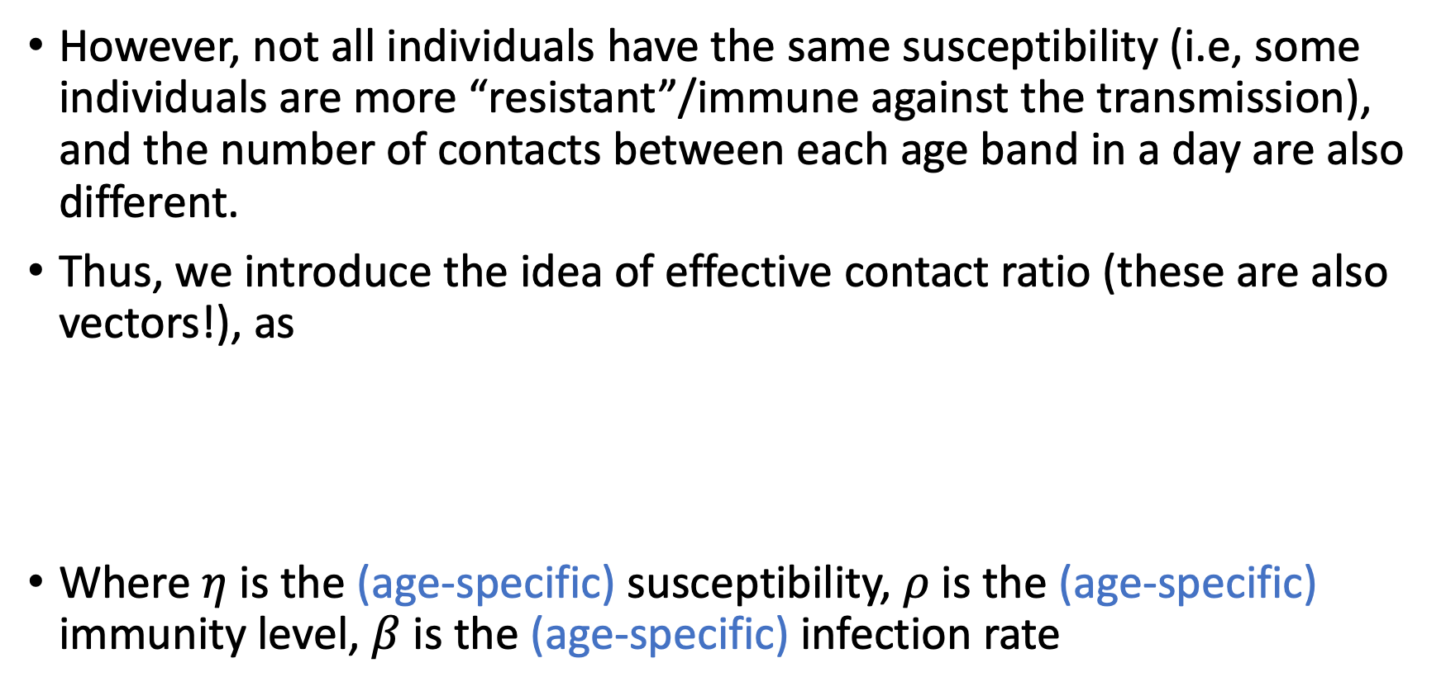
How does our model look like? – cont.
However, not all individuals have the same susceptibility (i.e, some individuals are more “resistant”/immune against the transmission), and the number of contacts between each age band in a day are also different.
Thus, we introduce the idea of effective contact ratio (these are also vectors!), as
Where $η$ is the (age-specific) susceptibility, $ρ$ is the (age-specific) immunity level, $β$ is the (age-specific) infection rate
Notes:
This quantity reveals “how likely is an individual get the disease pre contact”. For example, younger individuals are less susceptible to the virus and thus the ‘effectiveness’ per contact is lower.

Slide 14
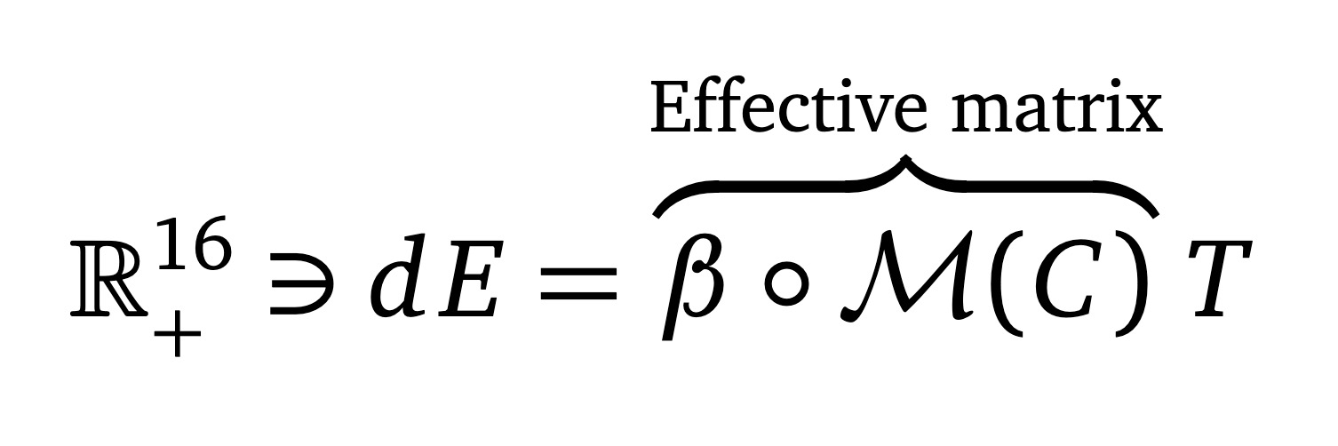
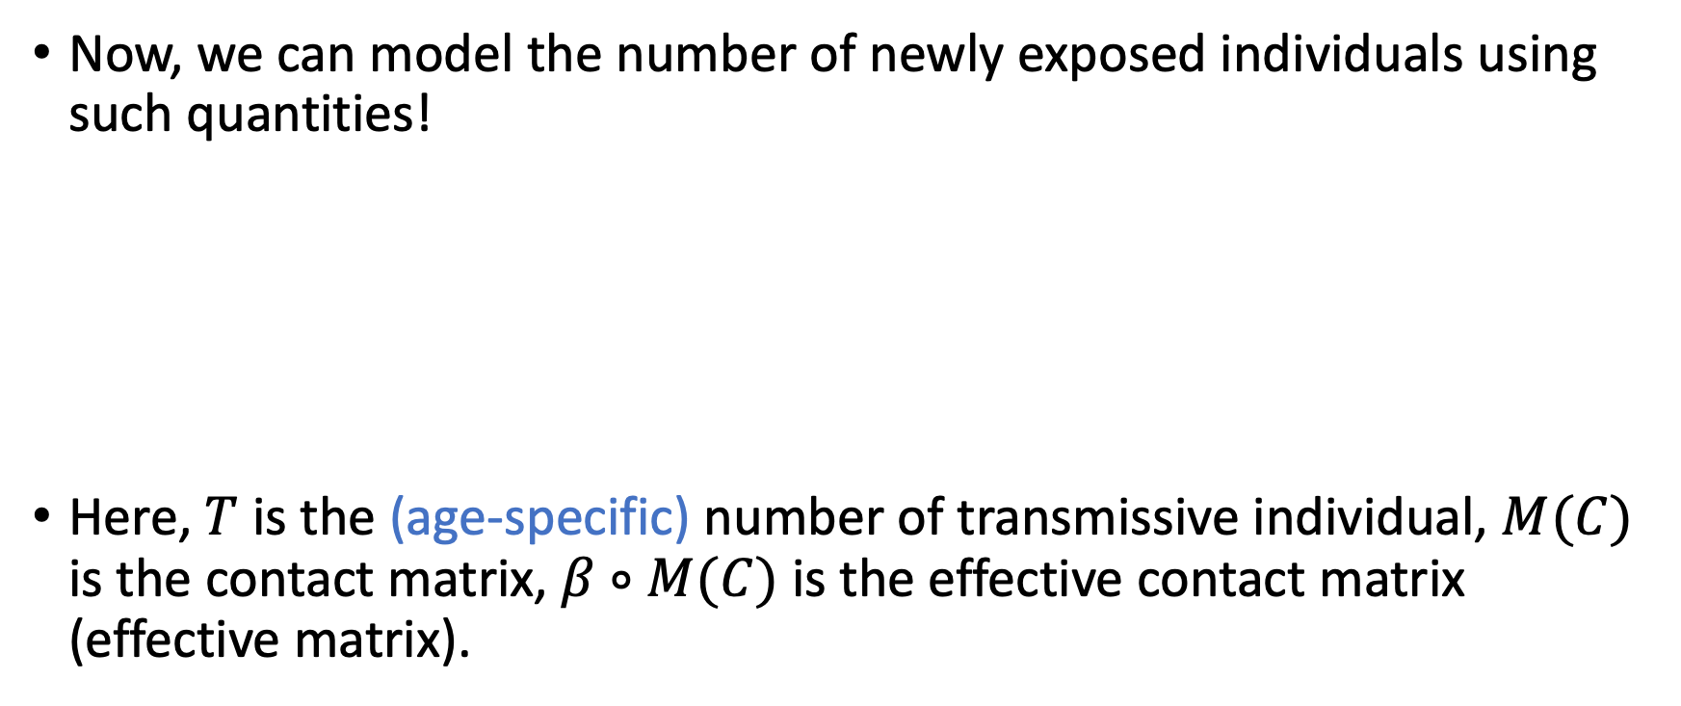
How does our model look like? – cont.
Now, we can model the number of newly exposed individuals using such quantities!
Here, $T$ is the (age-specific) number of transmissive individual, $M(C)$ is the contact matrix, $β∘M(C)$ is the effective contact matrix (effective matrix).

Slide 15
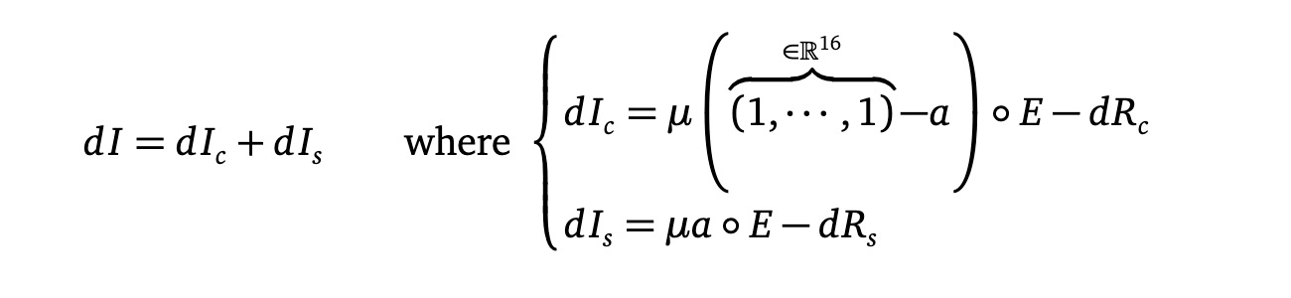
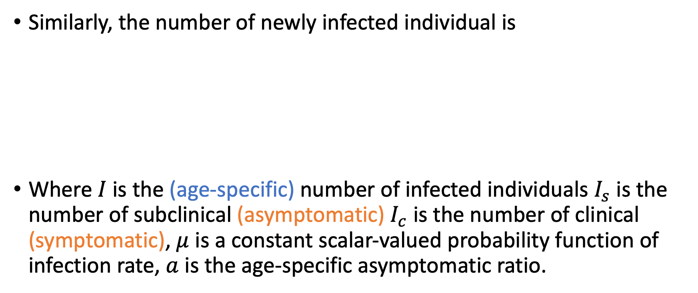
How does our model look like? – cont.
Similarly, the number of newly infected individual is
Where $I$ is the (age-specific) number of infected individuals $I_{s}$ is the number of subclinical (asymptomatic) $I_{c}$ is the number of clinical (symptomatic), $μ$ is a constant scalar-valued probability function of infection rate, $a$ is the age-specific asymptomatic ratio.

Slide 16
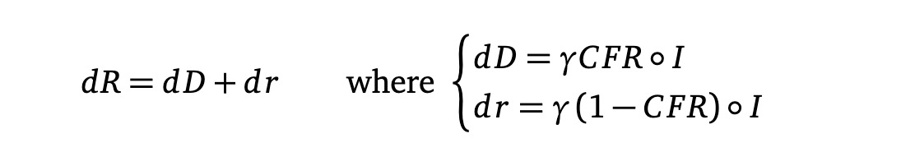
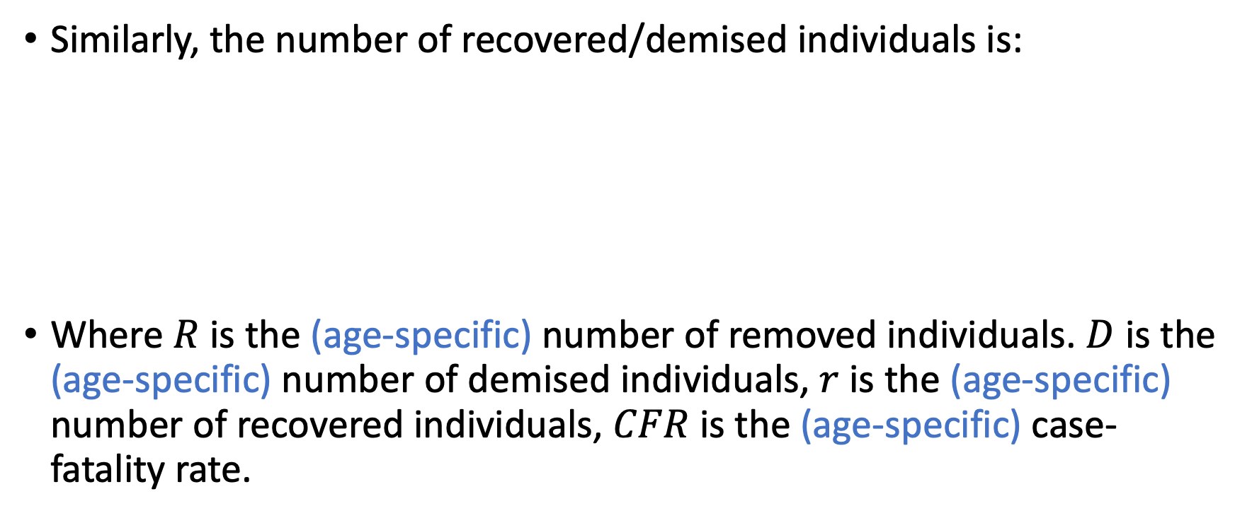
How does our model look like? – cont.
Similarly, the number of recovered/demised individuals is:
Where $R$ is the (age-specific) number of removed individuals. $D$ is the (age-specific) number of demised individuals, $r$ is the (age-specific) number of recovered individuals, $CFR$ is the (age-specific) case-fatality rate.

Slide 17
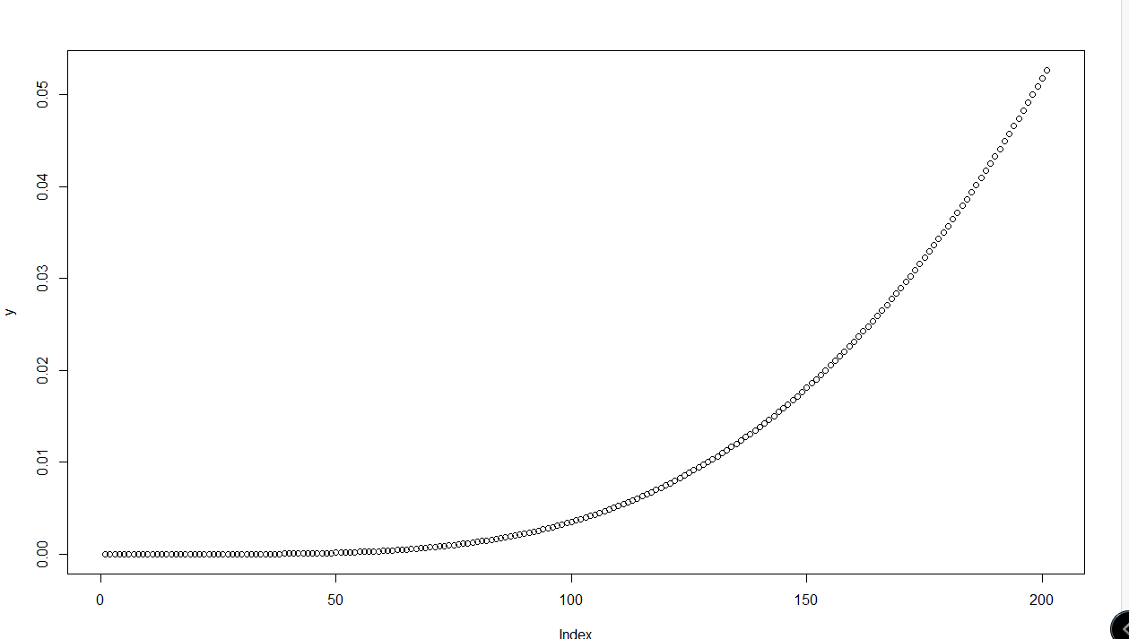
infected -> recovered & exposed -> infected
A gamma distribution! [REF], it’s something like this

Slide 18
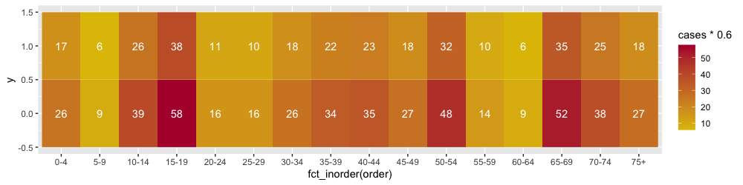
Commutation
We modelled the number of commute let’s consider the following array.
Assume the first row is the number of local-worker, and the second array is. The number of commuting workers.

Slide 19
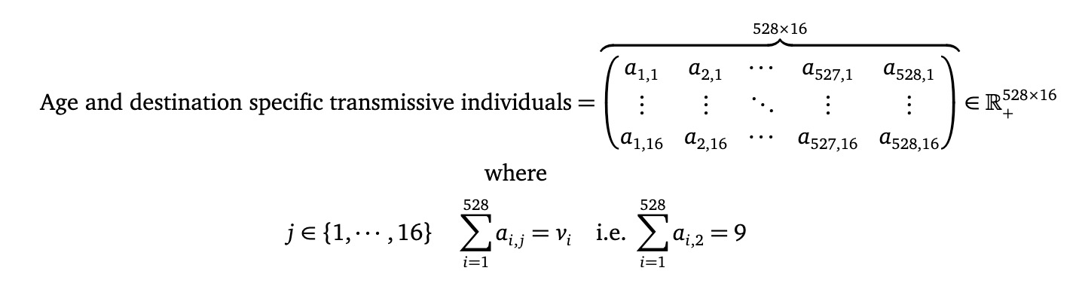
Commutation – cont.
Now, we reshape the second row into a 528 * 16 np.array, where the sum of each row is corresponding to the entry of the, for example:

Slide 20
Commutation – cont.
Intuitively, the in-coming commuters is also a 528 * 16 matrix. Such matrix will be reshaped (merged) into a 16-dimensional vector and will be used to calculate the number of new cases.
The number of new cases will then be re-distributed according to the weight of each entry (detailed description in supplementary material).
Essentially, just
reshape -> travel -> reshape -> transmission -> return -> reshape

